Slide 1
Mark Kempf
Vice President of Business Development
CP Technologies, LLC
markk@combatproven.tech
p: (858) 571-4330
m: (858) 750-8710
American Built, Combat Proven
Defense Capabilities Overview
Rugged Information Technology Systems & Data Link Solutions, and Systems Integration

Slide 2
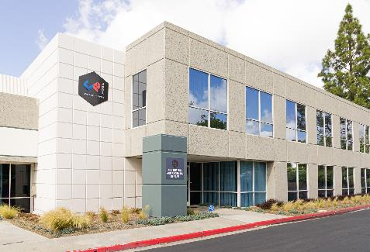
Company History
CP Technologies designs, fabricates and integrates standard and custom high-performance computing platforms, data links, keyboards and LCD displays for military, industrial, and commercial markets.
Innovative Modified-off-the-Shelf (MOTS) hardware solutions proven in rugged military land, maritime, and airborne environments.
Extensive experience with design, manufacture, test and evaluation, production and operations as well as extensive US military experience.
Technology Partners include Intel, Nvidia, CISCO, Dell
ITAR Certified
ISO 9001:2015 Certified
ANSI ESD S4.1 Antistatic Facility w/ 22,000 sqft manufacturing floor
Notes:
NAICS Codes
334111,334112,334119,334513,421430,443120,541420,541512,541519
Product Service Codes PSC D313, 7435
FSC 7021, 7042

Slide 3
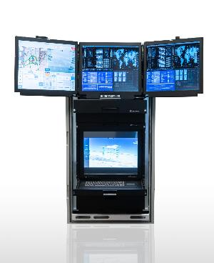
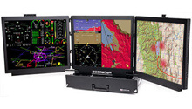
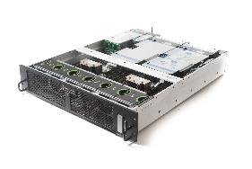
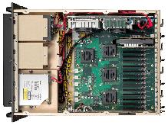
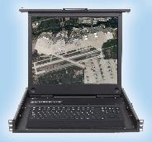
Rugged Components and Rack Solutions
Complete Rack Solutions
Computers & Servers (Mil-Std & Industrial)
Keyboards & Displays
Storage Arrays
Network Devices
SysCool™ Technology

Slide 4
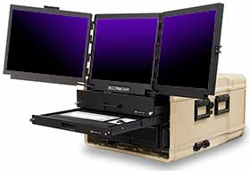
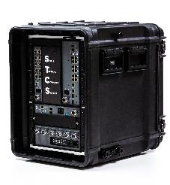
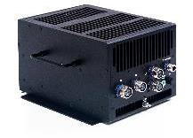
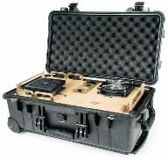
System Integration & Complete Solutions
Modified Off The Shelf (MOTS)
In House Non-Recurring Engineering (NRE) & SOLIDWORKS 3D design
Portable Systems

Slide 5
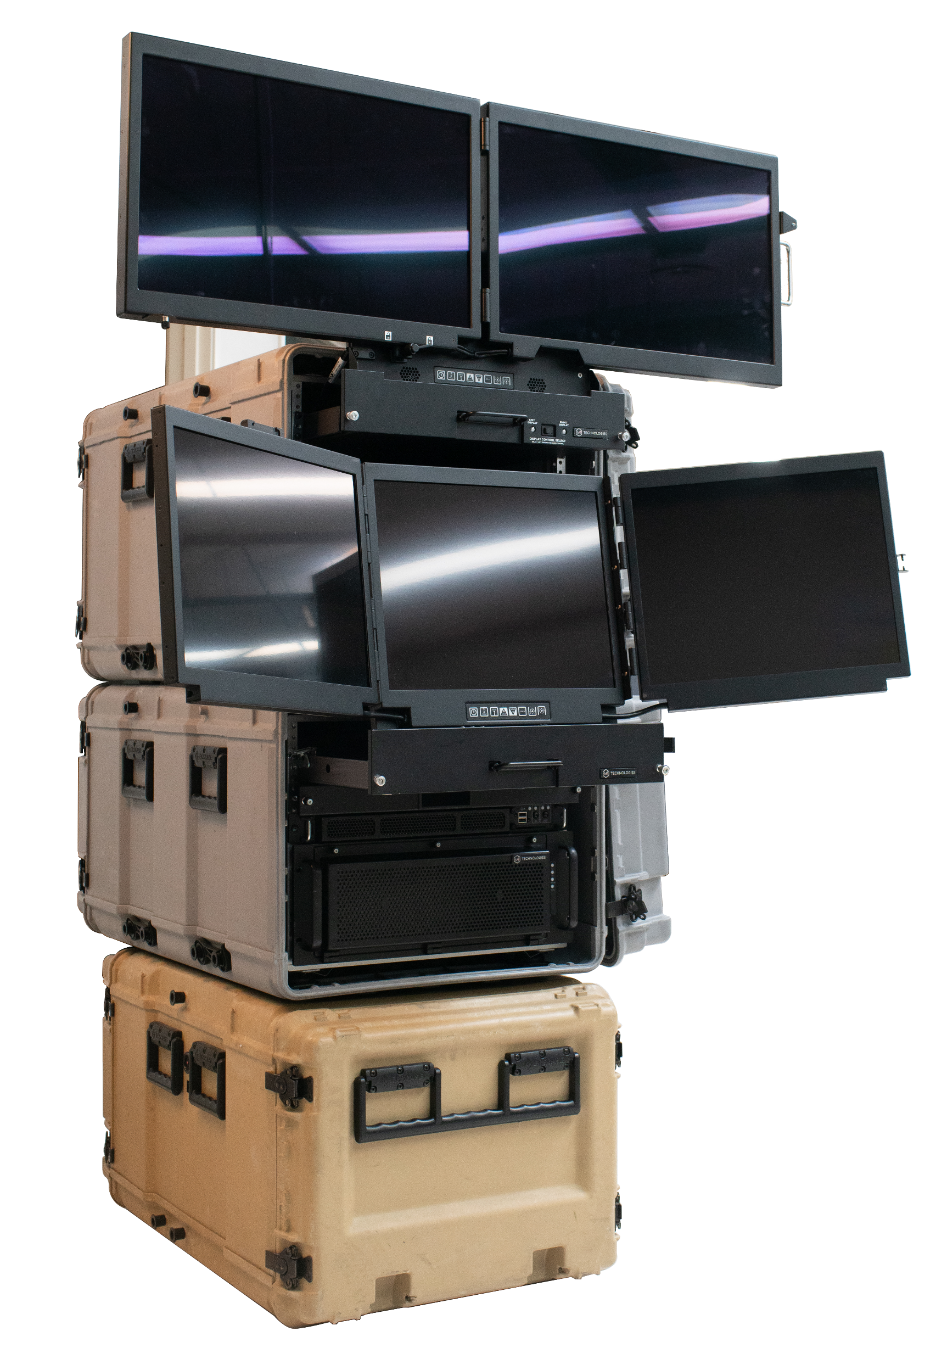
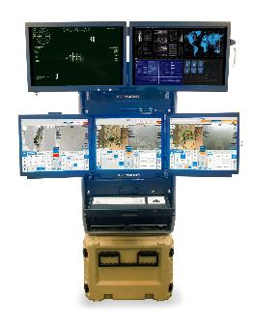
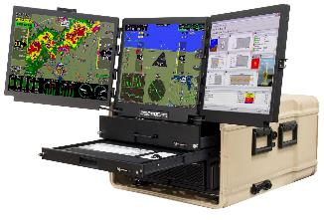
Complete Transit Case Solutions
Ground Control Stations
Scalable Mobile TOC Solutions

Slide 6
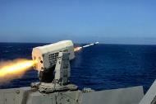
Market Segments & Focus
Military and Federal Government (70%)
Ground Control Stations
Shipboard Fire Control, Navigation, and ISR
Tactical Deployable Networks
Airborne Command & Control
Radar Processing
Sonar Data Recording
C5I Systems
Industrial/Commercial (30%)
Simulation & Entertainment
Autonomous Vehicles
Medical Diagnostics
Oil & Gas Exploration
Factory Automation
Mass Transit

Slide 7
Major Program Support
Navy
Ship Signal Exploitation Equipment
UCLASS X-47B
CVN’s
DDG’s
F-18 Flight Simulator
Rolling Airframe Missile (RAM)
Fleet Replenishment Oilers (T-AO’s)
Global Hawk Ground Control Station
Navigation Sensor System Interface (NAVSSI)
Low Band Universal Communication System (LBUCS)
Computer Open System Implementation Program (COSIP)
Next Generation Command and Control Processor (NGC2P)
Air Force
F-35 Matrix System
KC-46 Tanker
Radar Test Station
Joint Range Extension (JRE)
Pocket-J System
Firebird
RC-135
F-16 Flight Simulator
F-22 Flight Simulator
Highlighter Beechcraft King Air A-200T
Distributed Common Ground System (DCGS)
Ground Based Mid-Course
Gorgon Stare
Peace Dragon
Control and Reporting Center Operations Module (OM Mod)
Army
AH-64 Apache
Hunter UAV
Shadow UAV GCS
J-LENS
Kestrel WAPS
Predator
Patriot (PAC-3)
Vigilant Pursuit
Desert Owl IED Sensor Systems
Saturn Arch IED Sensor Systems
Radiant Falcon DHC-8 Aircraft
Tactical Data Link Integration Exerciser (TIGER)
Tactical Airspace Integration System (TAIS)
Marine Corps
Tactical Data Link Integration Exerciser (TIGER)
Joint Range Extension (JRE)
F-18 Flight Simulator
VIPER-T

Slide 8
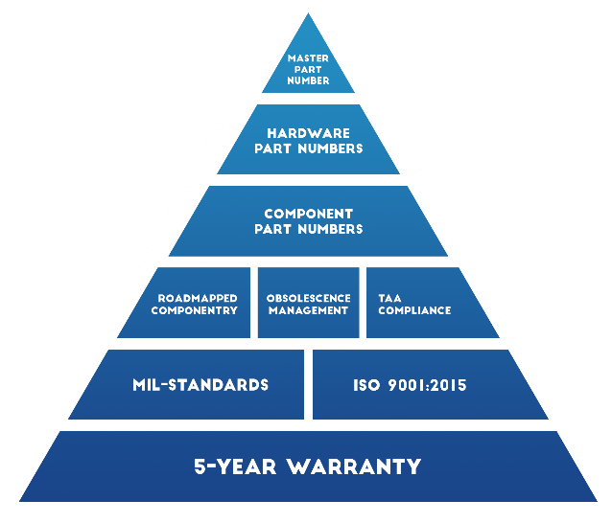
Systems Solution Management & Quality
Proven track record
Repeatable, well documented processes provide significant increase in unit throughput while maintaining consistent quality KPIs
Systems hardware requirements designed to meet software needs
100% Burn-In and Final Inspection
Option to burn-in software or ship ready to install
Manufacturing floor is a closed network to prevent cyber threats
Prototype to production of 900 systems in 90 days for USAF

Slide 9
Company Growth
Custom Military
Compute & Network Systems
Ground Control Stations
Datalinks
End-to-end combat proven UAS Solutions and Services
Fixed-wing UAS, VTOL UAS, Aerostats
Commercial UAS Solutions and Services
Custom Commercial/Industrial Solutions
Build to Print

Slide 10
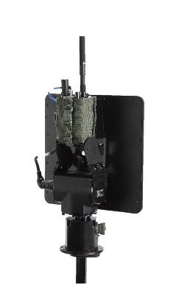
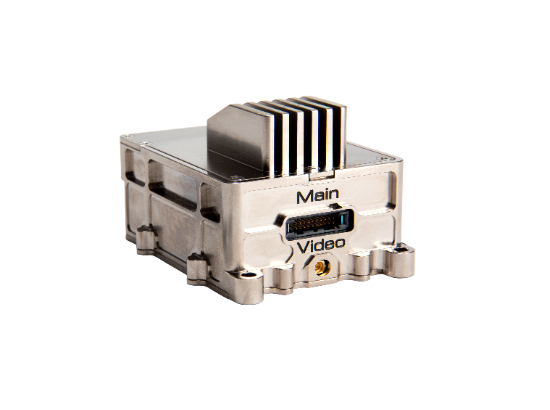
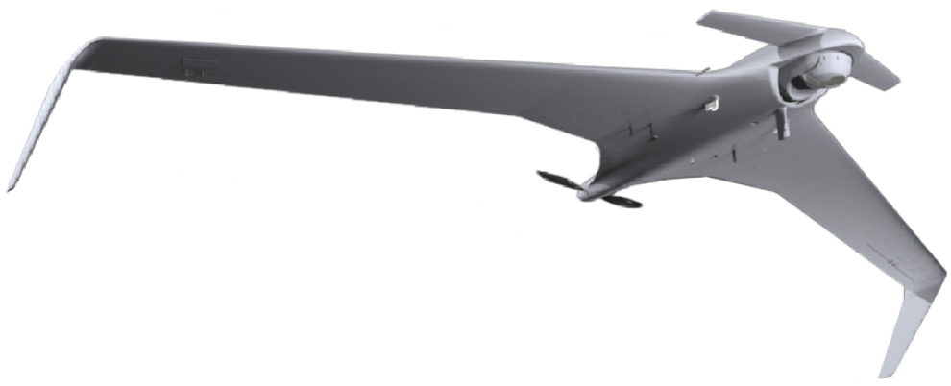
Vertically Integrated ISR Solutions
Portable IT Systems and Ground Control Stations
UAS Solutions
Datalink Solutions

Slide 11
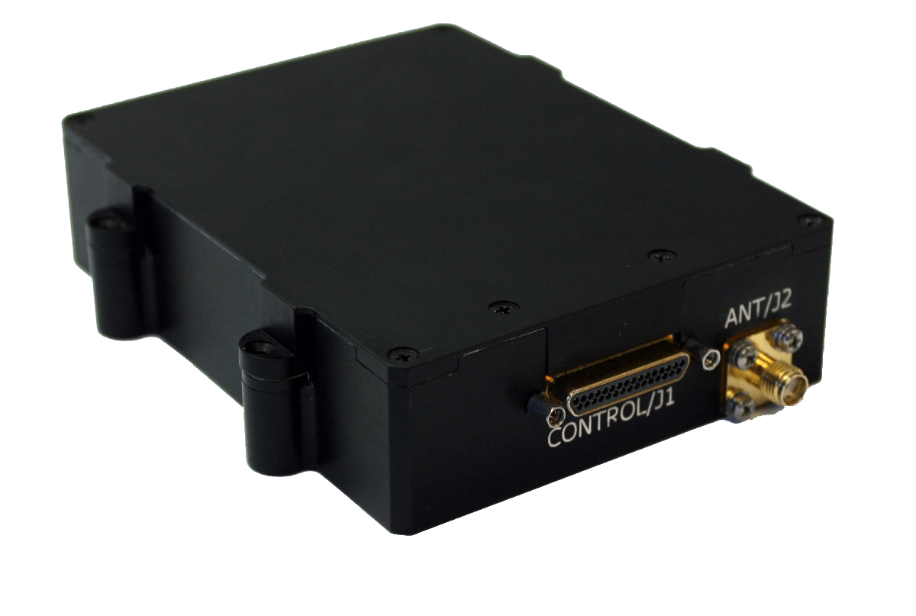
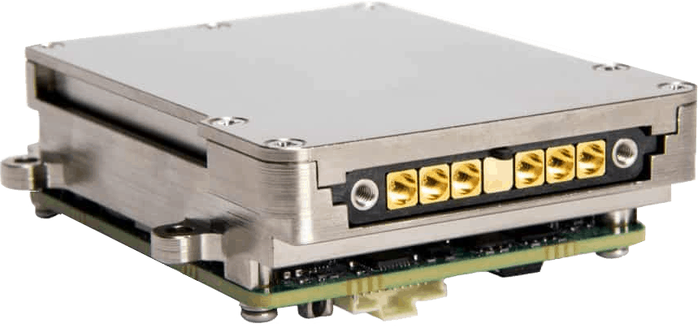
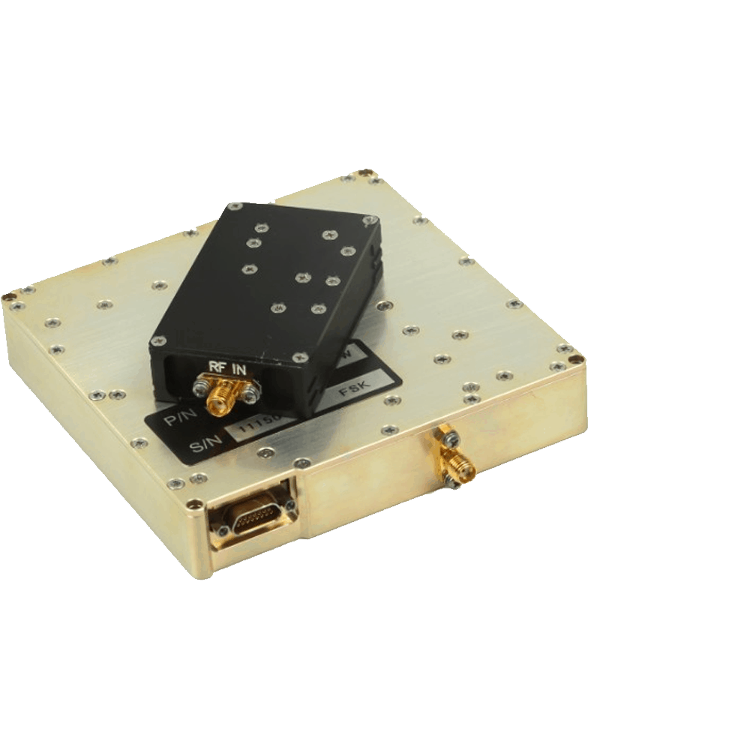
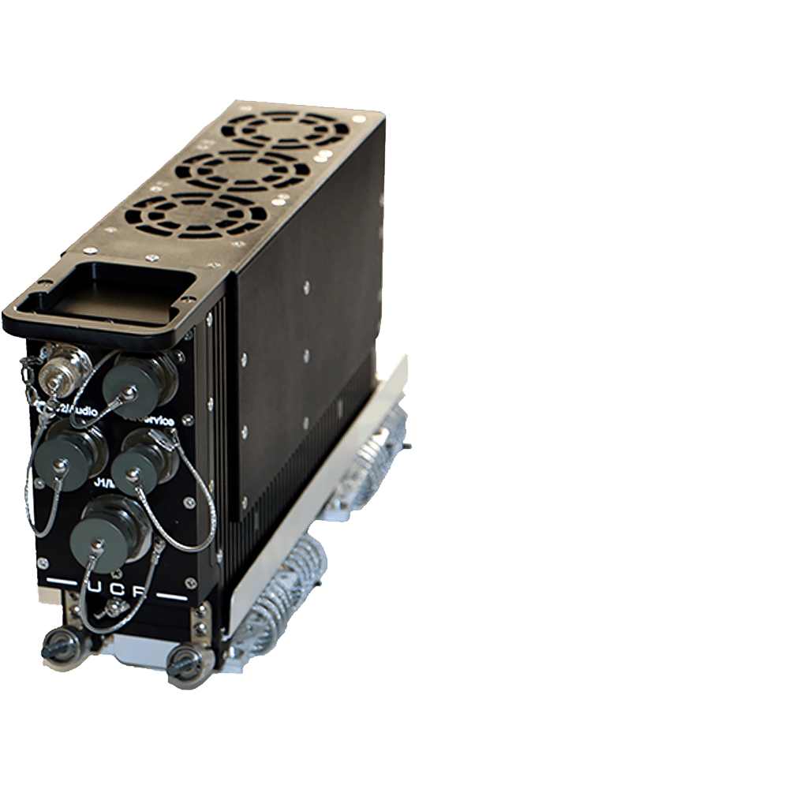
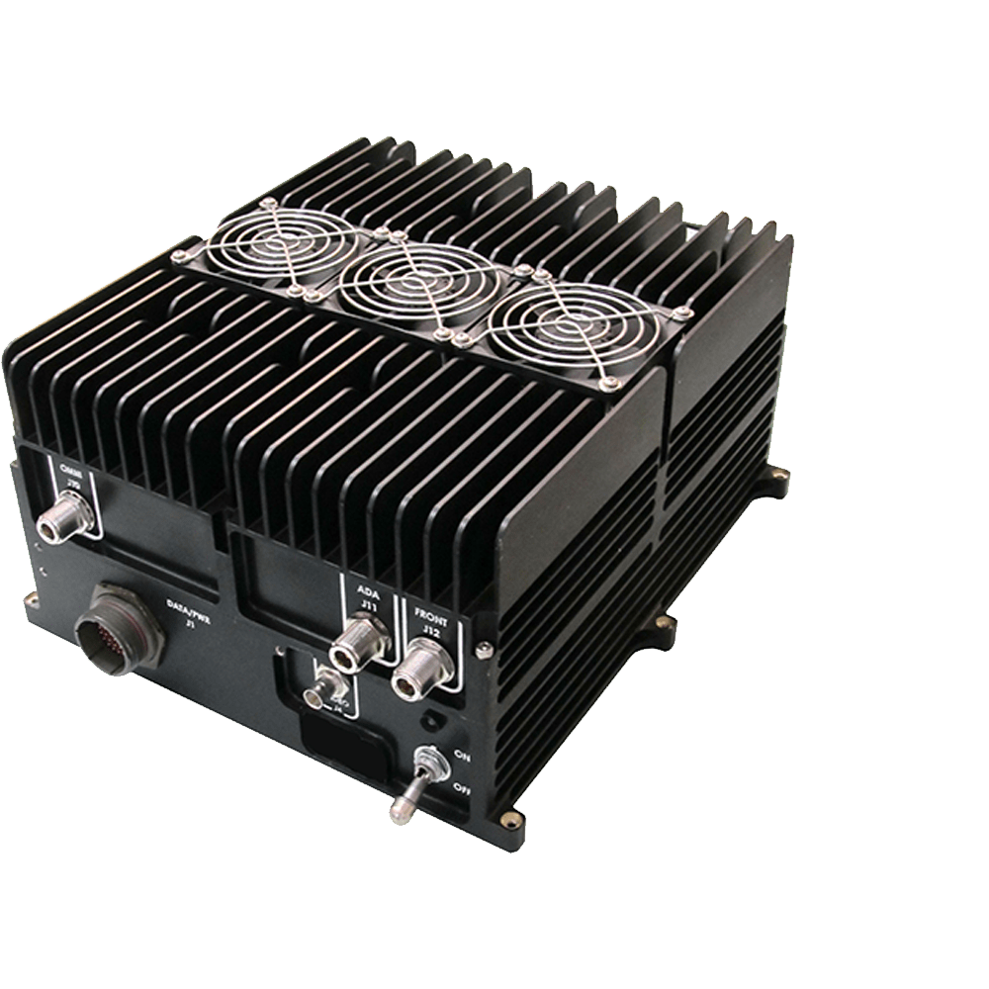
Datalinks Solutions
Software Defined Radio (SDR)
Small SWAP, High Performance
Forward Error Correction and full duplex digital comms
Direct Sequence Spread Spectrum (DSSS) and Frequency Hopping
Internal AES.256 encryption algorithm
H.264 Video encode/decode

Slide 12
Summary
Combat proven ruggedized IT and datalink solutions
Large selection of Modified Off The Shelf (MOTS) options
Rapid proto-typing and production ramp up capabilities
TAA compliant products
MIL STD designed and tested
Assembled and quality tested in San Diego, CA
Standard 5 year warranties
Technology partnerships include Intel, Microsoft, NVIDIA, Dell, CISCO
Revision control, configuration management and obsolescence management for the lifecycle of the program

Slide 13
Questions?
American Built, Combat Proven
www.combatproven.tech

Slide 14
Additional Information
American Built, Combat Proven
www.combatproven.tech

Slide 15
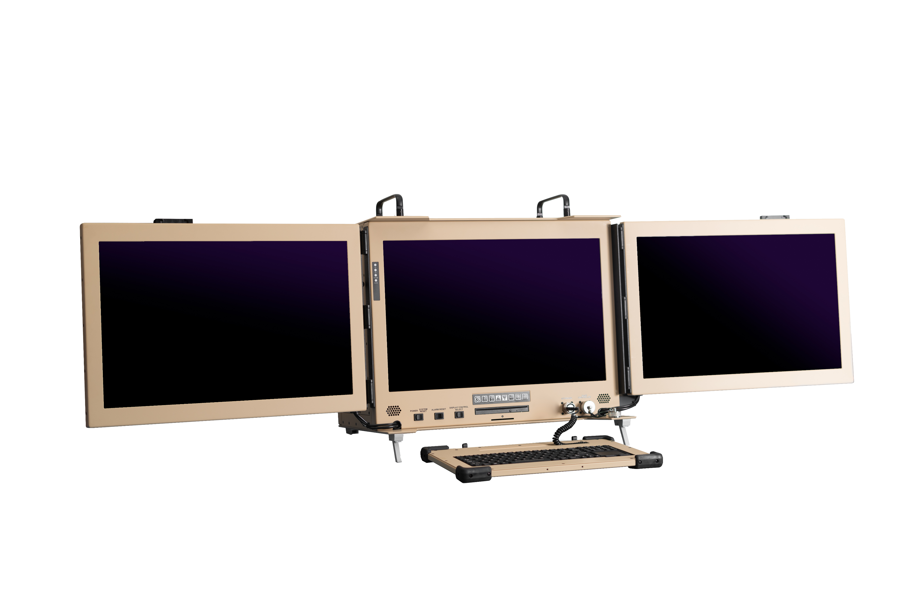
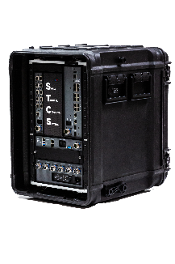
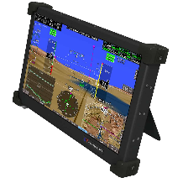
Portable Systems
Portable systems enable a complete high-performance desktop or server class computing systems complete with displays and input peripherals for deployment in the field.
Available in vehicle-mountable and 1 or 2 person carry
Ideal for mobile tactical networks
Scalable, mobile tactical operation center capabilities
CP offers cost effective industrial grade as well as Rugged military grade solutions.
Systems offered in both off-the-shelf packages as well as solutions custom tailored to specific applications and environments.
Various power options for each system to include 12VDC, 28VDC, 48VDC, and 110-240VDC
Designed to meet or exceed multiple MIL STDs to include 901E, 810G, and 461G

Slide 16
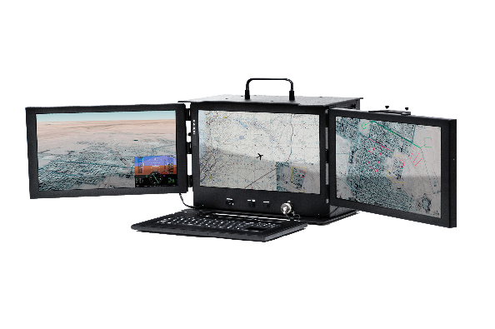
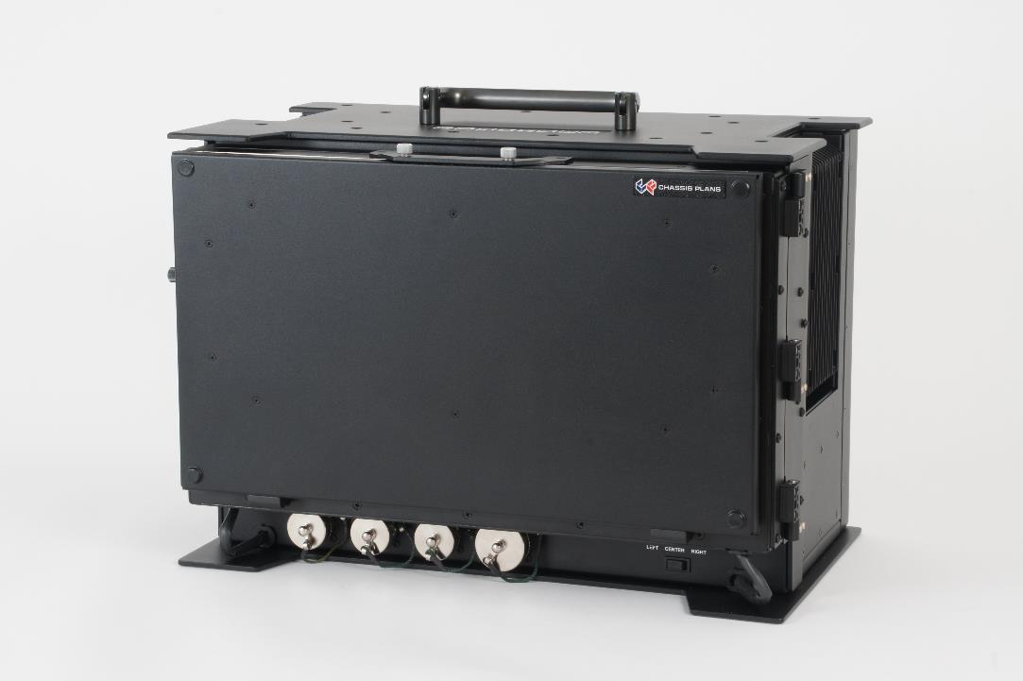
Military Tactical Portable (MTP)
The MTP portable computer system is a rugged, high-performance computing platform contained in the highly versatile “lunchbox” style form factor, allowing for a self-contained computing unit complete with three high definition displays and human input devices.
The MTP is built to CP Technologies’ high standard of ruggedness and will meet or exceed MIL-spec levels of performance in demanding environments.
The MTP may be configured with COTS componentry, allowing each unit to meet the levels of performance needed without compromising on its durability or its portability.

Slide 17
MTP Specifications
Features
Single or Triple Monitor Configuration
Formed and machined 5052-H32 and 6061-T6 aluminum alloy construction
Detachable Sealed IP65 Keyboard with Touch Pad
4x removable drive bays
Chassis Specifications
19.5” x 12.1” x 14.6” (495.3mm X 307.34mm X 370.84mm)
Max deployed width: 56.5” (1435.1mm)
40 lbs (approximate weight. Varies with configuration)
Black per MIL-PRF-24712, Type IV, Class 3, Cardinal C241-BK110 polyester semi-gloss, fine texture
Chem-Film per MIL-C-5541F, Type II, Class 1A

Slide 18
MTP Specifications
Computer Specifications
Up to Intel Core i7 or Xeon E3
(x4) DIMMs of DDR4 memory, up to 32GB Max Capacity
(x2) Sealed SATA III drives
(x4) Removeable SATA III drive bays JBOD, RAID 0, RAID 1
(x1) PCIe x16, (x1) PCIe x4, (x2) PCIe x1
(x3) PCI
(x1) RJ45 Gigabit Ethernet (second port optional)
DB-9 RS232 serial port
USB 3.0/2.0
Detachable 97-Key sealed touchpad keyboard featuring IP67 dust and splash resistance and green LED backlighting.
Integrated AC wide ranging power supply with rear mount external MIL-SPEC locking connector. Also available in wide-range DC input.
Display Specifications
(x3) 18.5” Full HD ( 1920x1080 ) LCD Panels mounted in a co-planar fashion
LCD Displays fold and lock into place for transport
3mm smudge-resistant AR coated soda lime float glass
Optional EMI shielded cover glass
1000:1 Contrast Ratio
80° ( L/R/U/D )
25ms Response Time
400 cd/m2
16.7M Colors

Slide 19
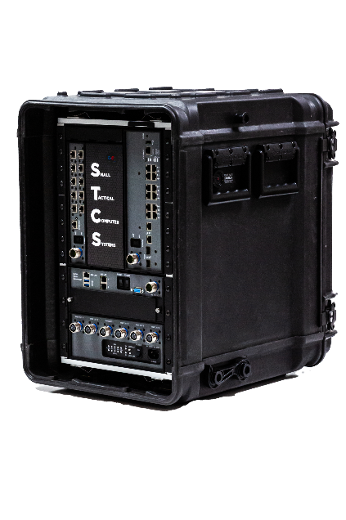
Small Tactical Computer Systems (STCS)
STCS implements small form factor modules that provide powerful Xeon processing performance optimized for virtualization applications, gigabit switching and routing capabilities and over 10 minutes of sustained battery backup time.
Module Specifications are tailorable to user requirements.
STCS are optimized for low size, weight and power (SWaP) to meet the demand of portability, reliability, and performance from any customer.
These systems accommodate flexible mounting options with brackets that can be mounted in a standalone configuration, to a bulkhead, in a half rack/case, or a standard 19” rack.
In a sealed system configuration, these STCS are designed for IP65 environments, as well as harsh environmental specs such as MIL-STD-810G, 901E, and 461G.

Slide 20
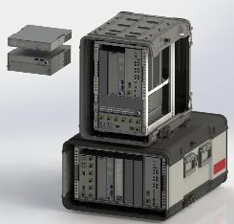
STCS – Data & Module Inforation
General
Dimensions & Weight
Transit Case - 22.25”H x 15.66”W x 24”D
Server - 3.45”H x 9.125”W x 11.25”D
Switch - 3.45”H x 10.20”W x 10.125”D
Router - 1.74”H x 9.125”W x 11.25”D
PDU - 3.45H x 11.25D x 9.125w x 11.25D
Approximate Weight – 60lbs
Construction
Sheet/Milled Aluminum
ROHS Compliant
IP65 Compliant Sealing
Conduction Cooled
Clear Chem Film and Black Powder Coating
Server Module
Scalable Xeon and Core processor options available
Up to 500GB DDR4 ECC/Non-ECC memory
1920 x 1080 graphic outputs
LAN with 1000Base-T / 10GBase-T
4x Removable SSD drives
Windows Server, Vmware, RHEL compatible
Serial RS232, Hardware RAID Controller (RAID 0, 1, 5), software sanitization of drives (Zeroize)
12VDC in

Slide 21
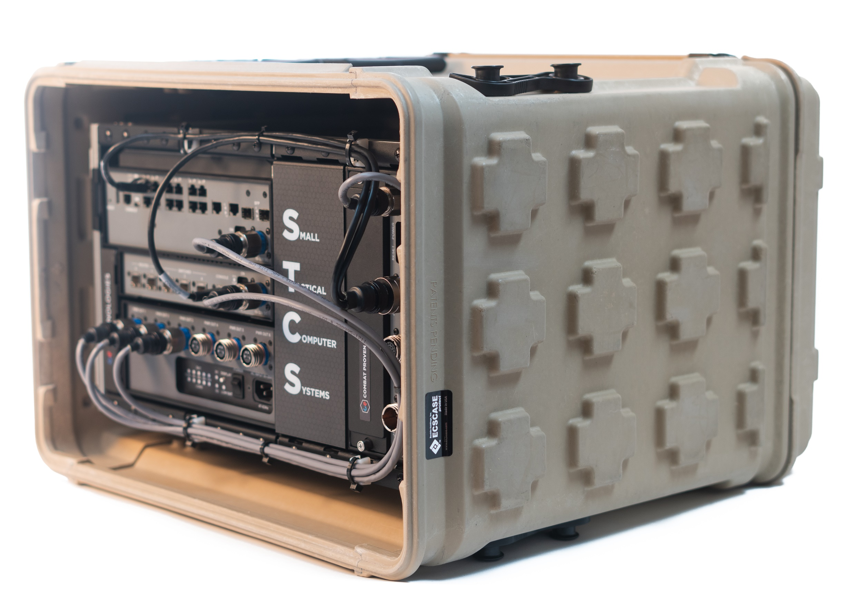
STCS – Module Information
Router Module
Onboard hardware encryption processor supporting IP Security (IPsec)
Secure Sockets Layer with transparent LAN services (SSL/TLS)
Secure Real-time Transport Protocol (SRTP)
Triple Digital Encryption Standard (3DES)
Advanced Encryption Standard (AES)
Internet Key Exchange (IKE)
Embedded Cisco ESR 5915
5x 10/100/1000 ports, 2x routed, 3x switched, 1x RS-232 Console port
2x 10GB SFP uplink (optional)
256 MB on-board flash memory, 512 GB DRAM
12VDC in
Switch Module
Embedded Cisco Catalyst 3560-CX
8x 10/100/1000 GE ports
2x 10GE copper/SFP uplinks
IP base (IP services with RTU license)
128 MB on-board flash memory, 512 GB DRAM
12VDC in

Slide 22
STCS – Module Information
UPS Module
500 Watt UPS
Lithium Iron Phosphate battery with >10 min Hold Time @ 80%
Universal AC Input of 96-132VAC and from 47-63 Hz
SNMP Based Network Connectivity for Status Monitoring
Over Voltage Capacity for Managed In-Rush and Startup Demands
Over Voltage and Over Temperature Protection Circuits
Common Safety Ground Connection
Integrated Battery Switch for long term storage protection
1x 110-240 VAC in, 5x 10-33 VDC out, Status and Indicator LEDs

Slide 23
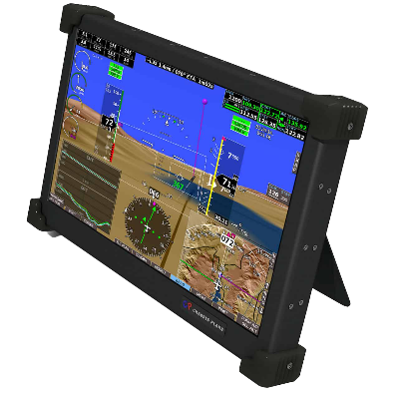
Rugged Zero Client Tablet
The CPZ-156 is a high performance VMware optimized Zero Client utilizing the PCoIP Protocol for the ultimate in Security with no operating system or user accessible Non-volatile Memory.
This device provides the optimal user end-point for Virtual Desktop environments based on VMware Horizon with View.
Designed to be a state-of-the-art secure information device, the CPZ-156T is designed from the beginning for security, first and foremost.
The CPZ-156T is powered through the IEEE- 802.3 at Power over Ethernet connection. This means a single push-pull connector is all that is required to lose all display information on the Ruggedized Client.

Slide 24
CPZ-156T Specifications
Features
Robust Network Protection
Comprehensive Patch/Version Management
Rugged Design
Power over Ethernet
Revision-Controlled Components
Optional Carrying Case
Chassis Specifications
20W Power Consumption
IEEE 802.3at Compliant
12 VD +/- 5%
15” (wide) x 9.5” (high) x 1.5” (deep)
6.0lbs (2.7 kg) / 15lbs (6.8 kg) in Protective Case
Rugged Aircraft-Grade 0.062” 5052-H32 Aluminum Construction
Integrated Multi-Touch Panel Interface
Fully Configurable Peripheral Ports for Human Interface Devices (HID) or Secondary Authentication
Integrated Stand for Easy Viewing

Slide 25
CPZ-156T Specifications
Zero Client Specifications
Teradici TERA2321 PCoIP
32MB Flash (Firmware)
512MB DDR3
VMware Ready
PCoIP Connected
(2) USB 2.0 for HID
Networking: 10/100/1000 Base-T
IEEE 802.3at Compliant
12 Pin Push/Pull Ethernet
6 Pin Push/Pull Peripheral Port
Display/Touch Screen Specifications
High Quality 15.6” LED Backlit TFT LCD w/Antiglare Hard Coating
Borosilicate Strengthened Cover Glass
13.5” x 7.6” (344mm x 194mm) Active Area
300cd/m2 typical
1920 x 1080 Resolution
Conductive Stylus/Finger with 0G Op Force

Slide 26
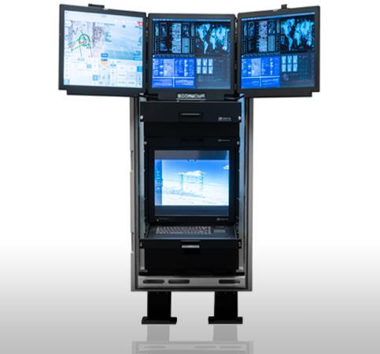
Complete Rack Solutions
User Definable Configurations
Fully Configured for Plug & Play
Global AC or DC Power
MIL-STD’s 810G, 901D

Slide 27
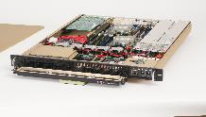
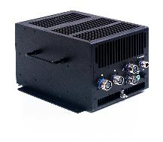
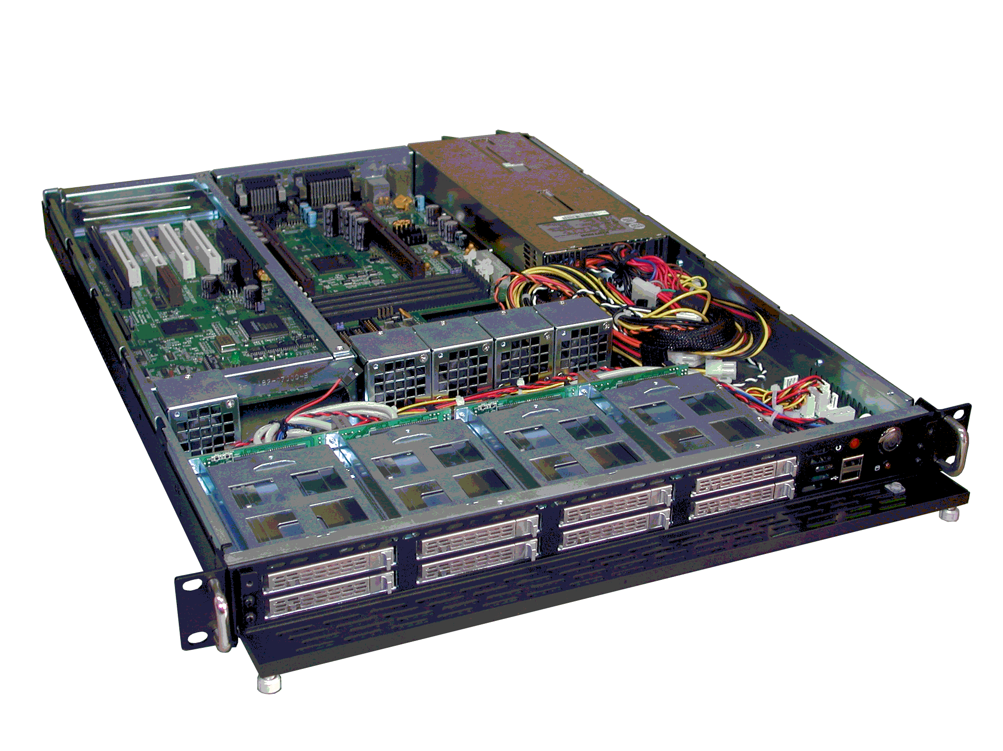
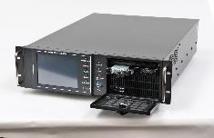
Computers and Servers
Rugged Rackmount Computers
Light Industrial for Benign Environments
Commercial Towers Systems
Mission Computers
Full Revision Control and Configuration Management

Slide 28
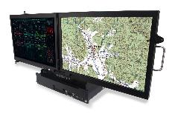
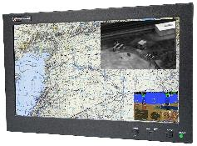
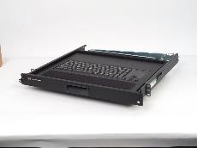
Monitors & Keyboards
LCD Displays and Keyboards
Panel Mount and Rackmount
Single Screen and Multi-Screen
AC and DC Voltage Options
Multiple Options to Include NVIS, Touch Screen and Direct Sunlight Readable

Slide 29
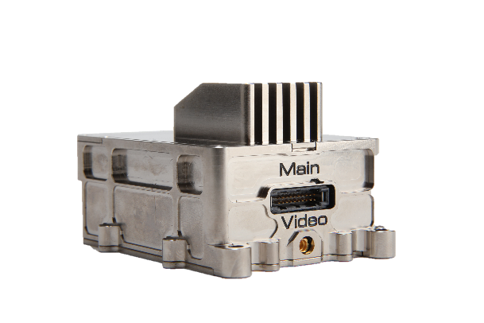
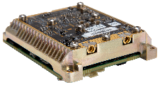
Enhanced Micro Data Link System (EMDLS)
Full Duplex (UPL & DNL)
60km Max Range
Size/Weight dependent on Video Encoder and Case
0.13lbs (60g)
2.4” x 2.05” x 0.79” (61mm x 52mm x 20mm)
10-12W Power Consumption
Transec Comsec
Relay Operation Capable

Slide 30
Advanced Mini Link System (AMLS)
Full Duplex (UPL & DNL)
150km Max Range
0.66lbs (300g)
1.06” x 3.74” x 4.53” (27mm x 95mm x 115mm)
23W Power Consumption
Transec Comsec
H.264 Encode/Decode
Relay Operation Capable

Slide 31
Integrated Data Link System (IDLS) MK-II
Full Duplex (UPL & DNL)
250km Max Range
5.51lbs (2.5kg)
9.37” x 8.74” x 1.65” (238mm x 222mm x 42mm)
160W Power Consumption
Transec Comsec
H.264 Encode/Decode
Relay Operation Capable

Slide 32
UHF/VHF Radio
Full Duplex (UPL & DNL)
250km Max Range
4.19lbs (1.9kg)
10.28” x 6.1” x 1.92” (261mm x 155mm x 49mm)
150W Power Consumption
Transec Comsec
VoIP Capable
ATC Radio Comm
Wide frequency transceiver – 30-512MHz

Slide 33
Secondary Link & FTS UHF
Half Duplex
250km Max Range
0.13lbs (60g)
0.67” x 1.61” x 2.76” (17mm x 41mm x 70mm)
<1W Power Consumption
Transec Comsec
FTS Capable
Secondary Link system for AMLS and IDLS Mk.2

